Slide 1
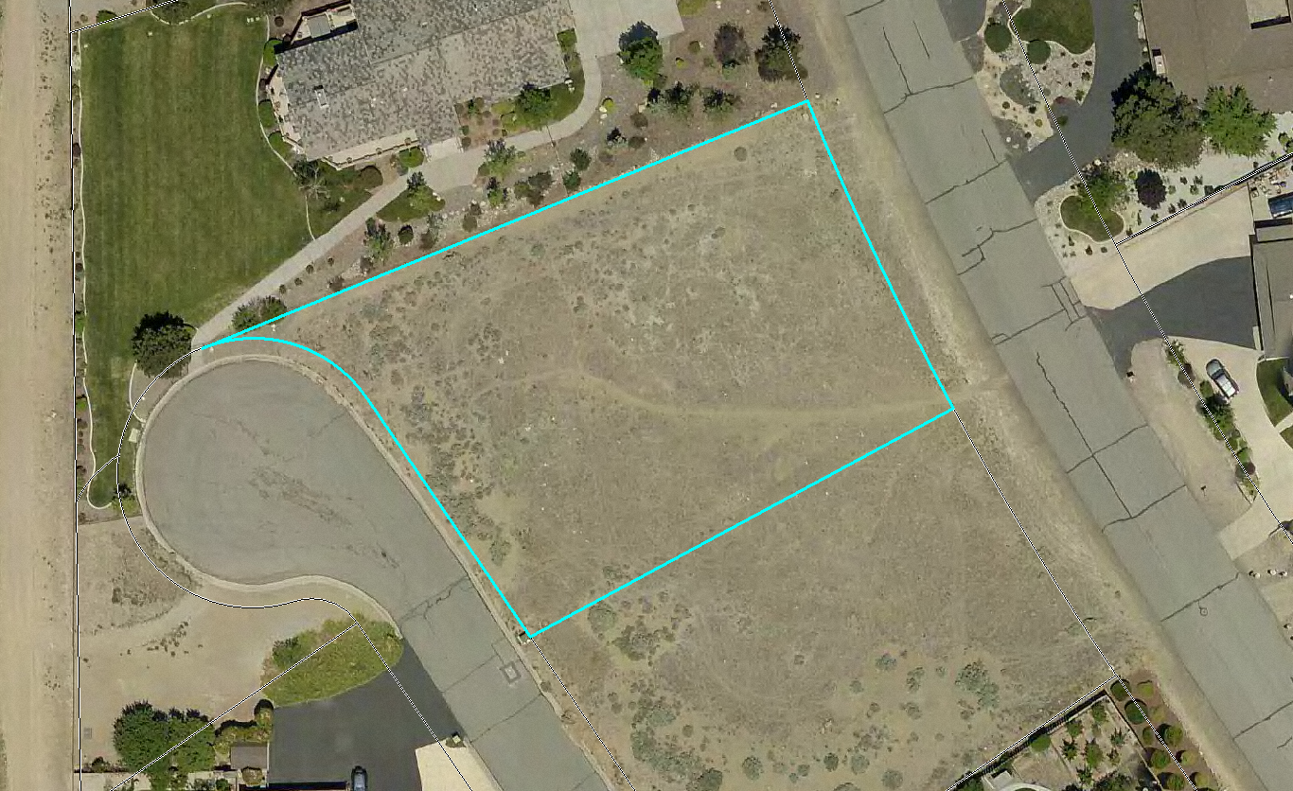
WPVAR18-0004 EEKHOFF RESIDENCE
Eekhoff Property
Hidden Valley Dr.
Briar Hills
Washoe County Board of Adjustment
August 2, 2018

Slide 2
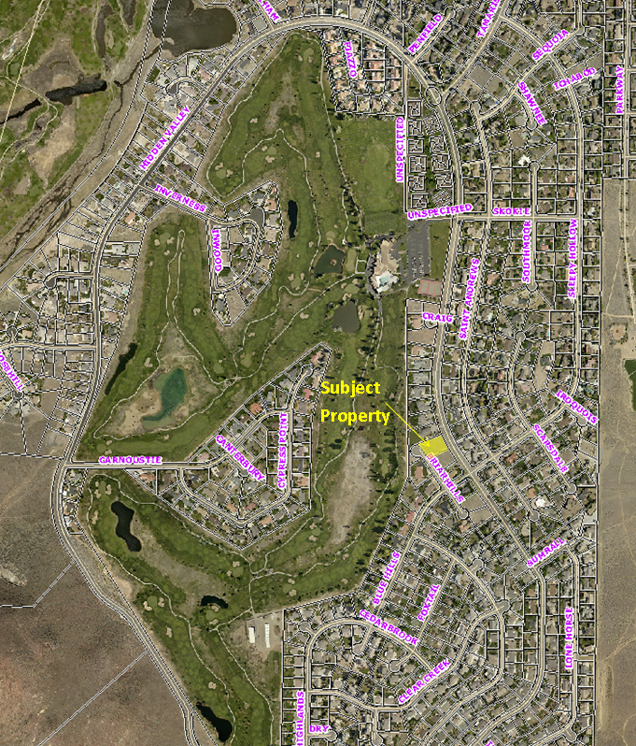
Vicinity Map
Address: 5545 E. Hidden Valley Dr.

Slide 3
Overview
Reduce font yard setback from 30’ to 20’ along the west property line.
Reduce front yard setback from 30’ to 20’ along the east property line.
Reduce side yard setback from 15’ to 8’ along the north property line.
To bring a home into conformance with code that was permitted in violation of setbacks.

Slide 4
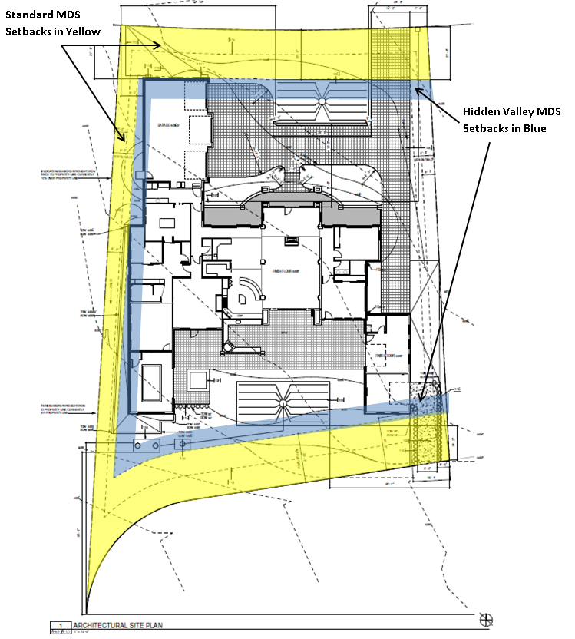
Site Plan

Slide 5
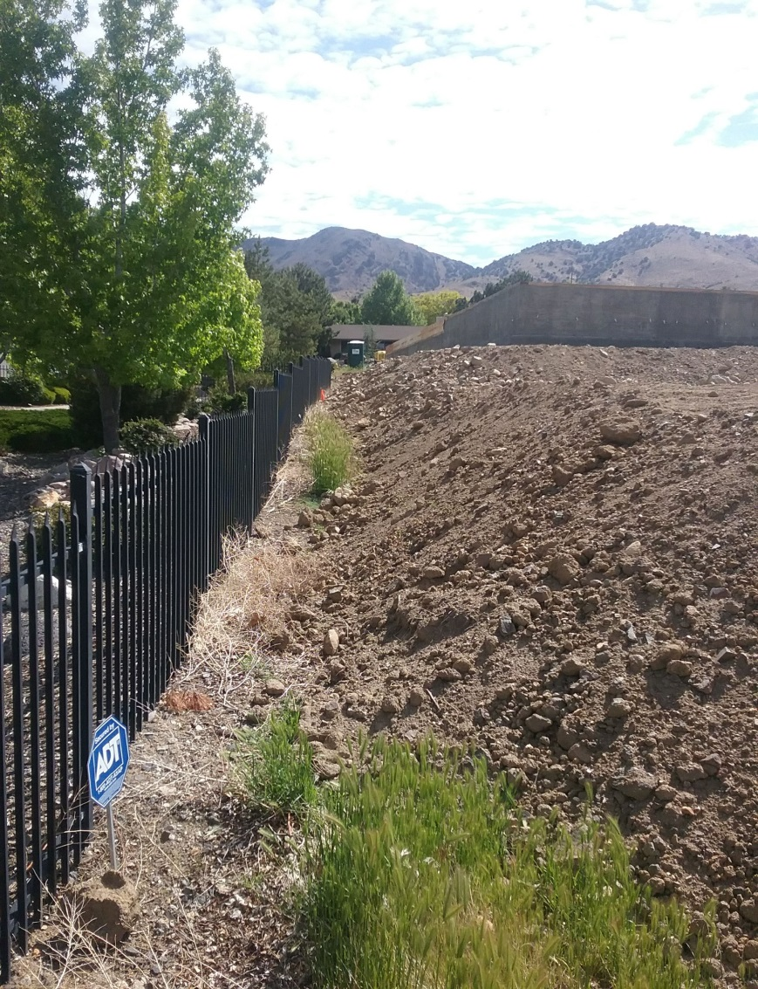
Site Photo

Slide 6
Grading Requirements
Not result in slopes on fill in excess of or steeper than four to one (4:1).
Not result in elevations or fill that differ from the natural grade by more than forty-eight (48) inches or when grading occurs adjacent to an existing residence.
Fills shall not be placed within an area that exceeds a projected slope of four to one (4:1) for a distance of forty (40) feet from the common property line.

Slide 7
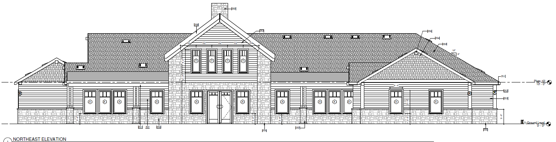
Elevations
Front Elevation Facing Hidden Valley Dr.

Slide 8
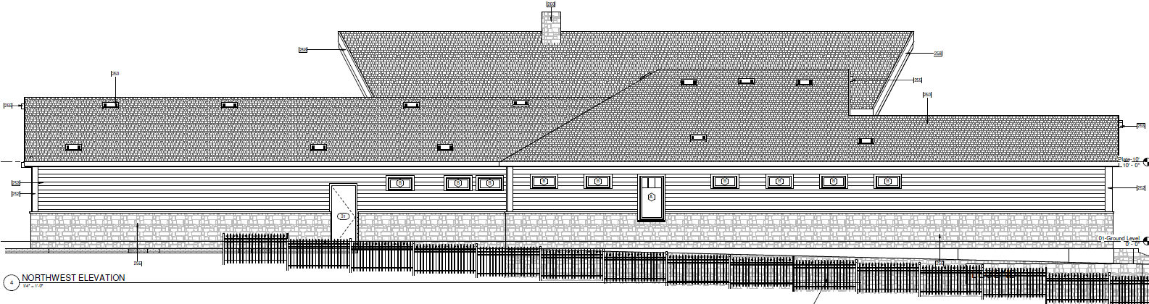
Elevations
Side Elevation Facing Shaver Residence

Slide 9
Rendering

Slide 10
Findings
Special Circumstances. Because of the special circumstances applicable to the property, including extraordinary and exceptional situation or condition of the property and/or location of surroundings; the strict application of the regulation results in exceptional and undue hardships;
No Detriment.
No Special Privileges.
Use Authorized.

Slide 11
STM/WV CAB
South Truckee Meadows/Washoe Valley CAB
  Discussed the item at the July 5, 2018 meeting
  Unanimous recommendation for approval

Slide 12
Commenting Agencies
Washoe County Community Service
  Planning and Building Division
    Planning Section
  Engineering and Capital Projects
    Land Development

Slide 13
Possible Motion for Approval
I move that, after giving reasoned consideration to the information contained in the staff report and information received during the public hearing, the Washoe County Board of Adjustment approve Variance Case Number WPVAR18-0004 for Eekhoff residence, with the Conditions of Approval included as Exhibit A for this matter, having made all four required findings in accordance with Washoe County Code Section 110.804.25

